Slide 1
Extension of PBS Monitoring Tool
Internship: Tool Developer within IT
Name: Shruti Kulkarni
Advisor: Prof.Dr Martin Thost
Supervisor: Mr. Michael Salzmann
Subject: Software Validation
Company: Airbus Helicopters GmbH
Date: 15.02.2016

Slide 2

Objectives
High Performance Computing
Architecture
System Software
Programming Environments and Tools
Application
Software Validation

Slide 3
Contents
Introduction to High Performance Computing
Architecture
System Software
Programming Environments and Tools
Web Based Application
PuTTy
PBS Shell Commands
PBS Resources
Torque
Shell in PHP
Specification fulfillment for extension of application Application
Software Validation
Migration of Web Application
Conclusion
Bibliograph

Slide 4



High Performance Computing
E-commerce/anything

Slide 5

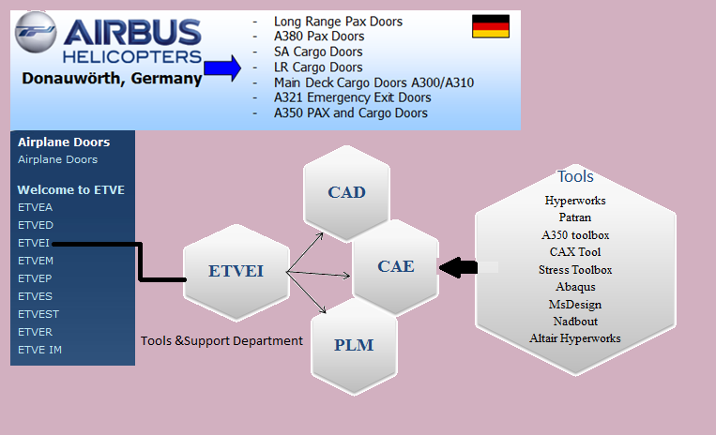
Architecture

Slide 6
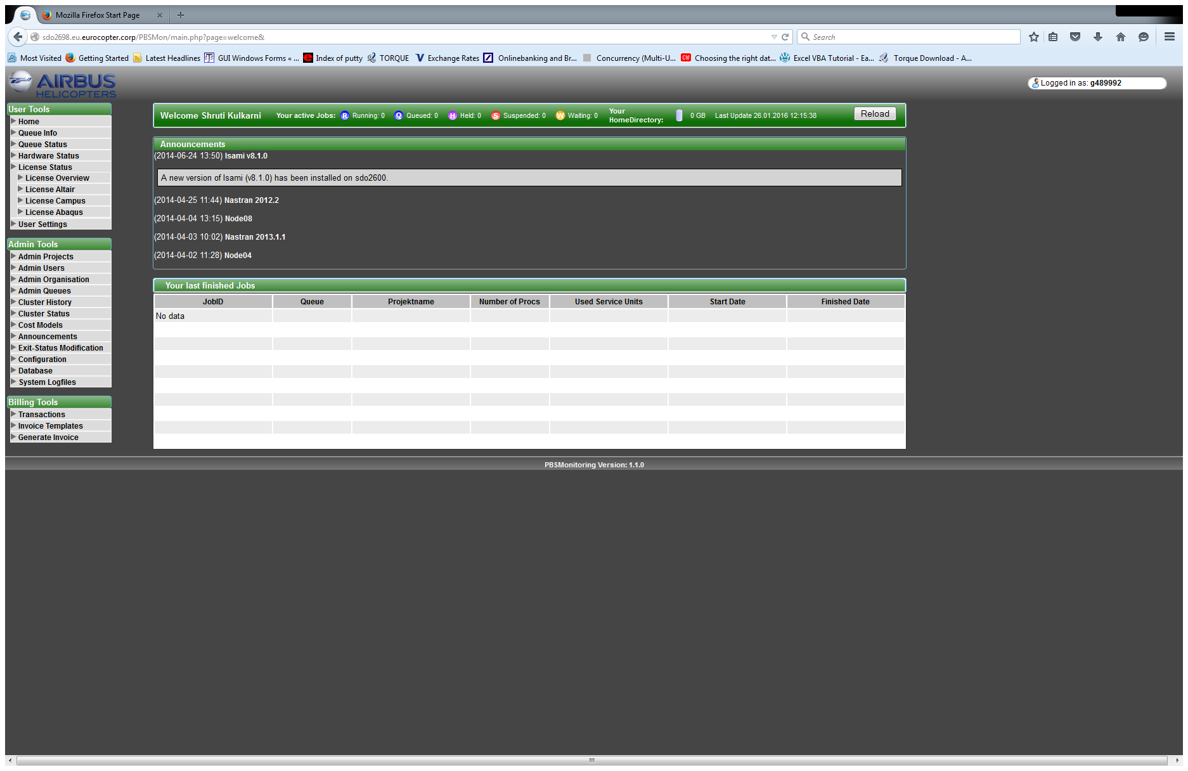
System Software
Web based application
Frontend PHP with embedded HTML,
Css styling
Java Script software validation
AJAX
Torque
Linux RedHat 6
MySQL Server

Slide 7
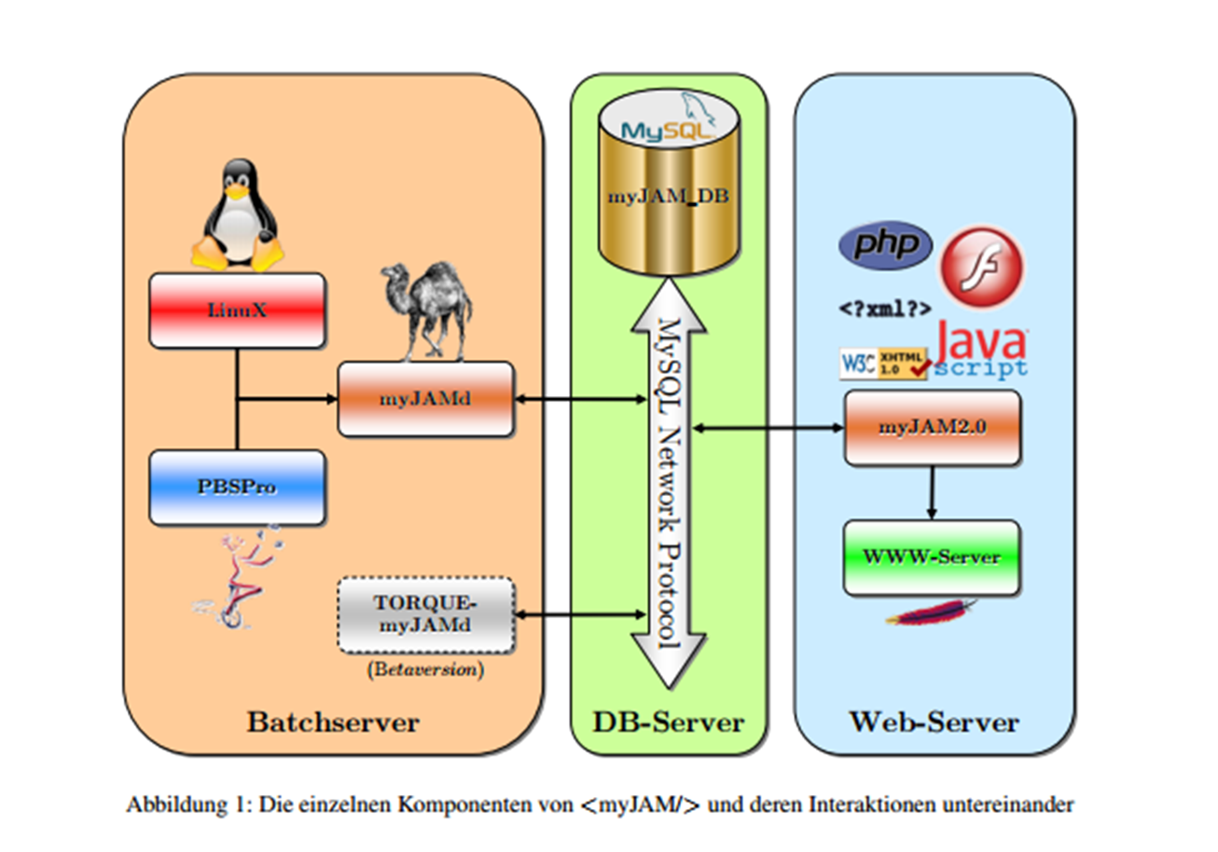
Web based application

Slide 8
sdo2698
Prologue
sdo2600
MySql Server
Epilogue
sdo2699
Node

Slide 9
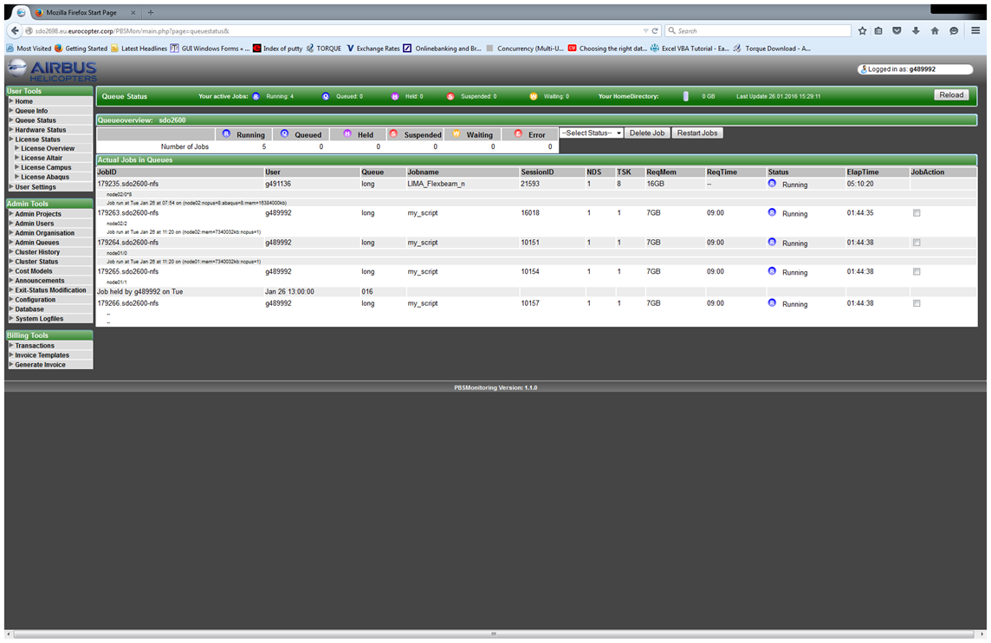
Frontend PHP with embedded HTML

Slide 10
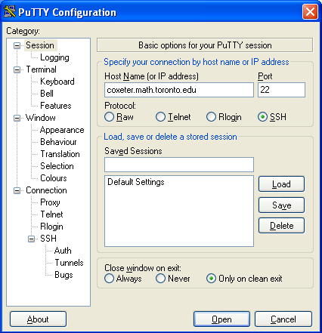
PuTTY
User connection to server
Remote login
Submit their calculations to specific the server
Main task to automate the process and provide it from frontend
Motive to avoid PuTTY

Slide 11
PBS Shell Commands
When you submit and monitor jobs on compute clusters, you are using TORQUE - a version of PBS.
A popular open-source resource manager, TORQUE is used at thousands of research sites globally.
With the commands available through TORQUE you can allocate resources, schedule and manage execution, monitor and view the status of your jobs.
Some of TORQUE's commands are used at the shell command line, others are embedded in the shell script that runs your program.

Slide 12
Torque
qsub | Submit a job.
qstat | Monitor the status of a job.
qdel | Terminate a job prior to its completion.
qhold | Suspends the job and sends it into held state showing that the job is still running
qrls | Restarts the job
qsig | Suspends the job

Slide 13
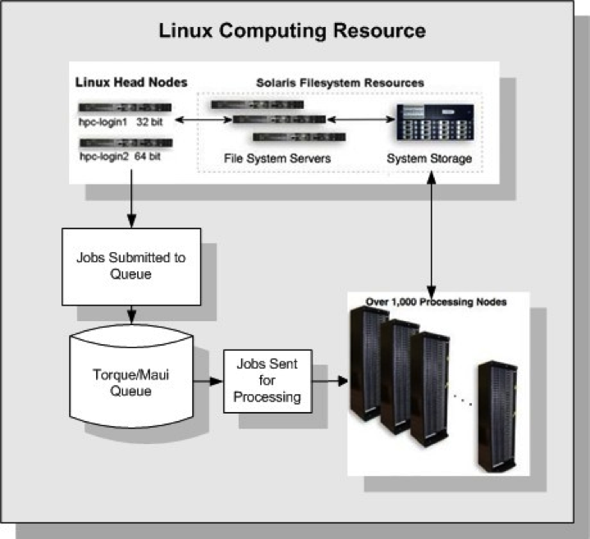
Work flow
qsub

Slide 14
PBS Resources
In the batch script, you can specify the resources needed by your job.
This does not mean that you can just specify the maximum amount of resources possible at all times.
PBS tries to optimize the utilization of resources and to balance the job load.
If current resources does not meet your requirement, PBS will let your job wait in the queue and pick a job in the queue, whose job requirement can be satisfied by the current resources, to run.

Slide 15
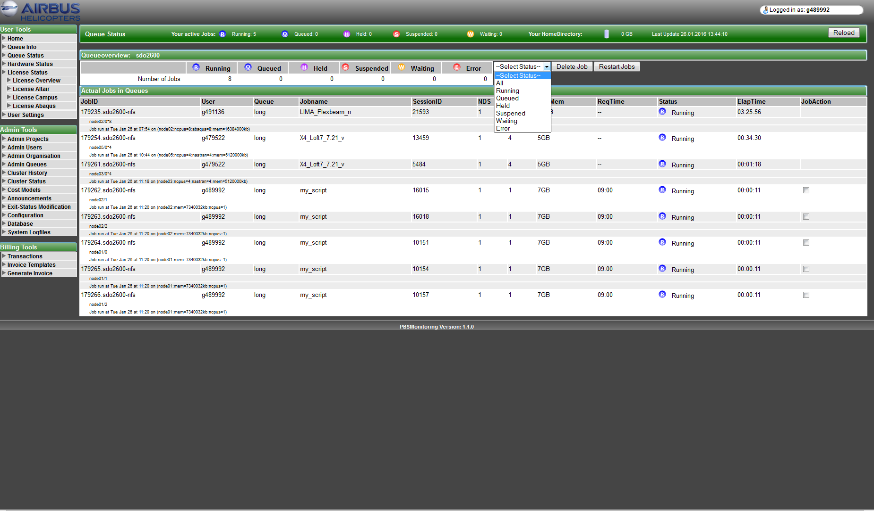

Slide 16
Shell in PHP
Shell script in PHP
Extracting data to an text file
Reading the entire text file which contains the output
Displaying it on frontend and sorted into it‘s particular status on user demand.

Slide 17
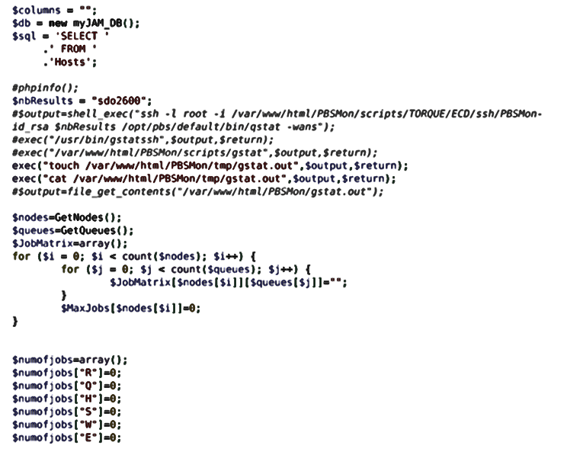

Slide 18
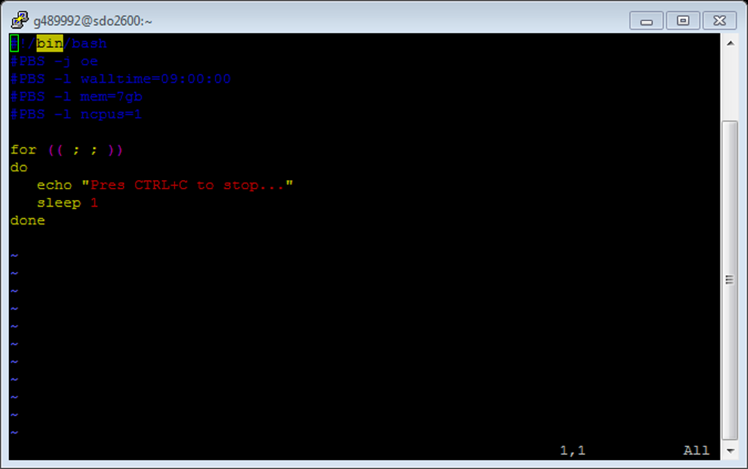

Slide 19
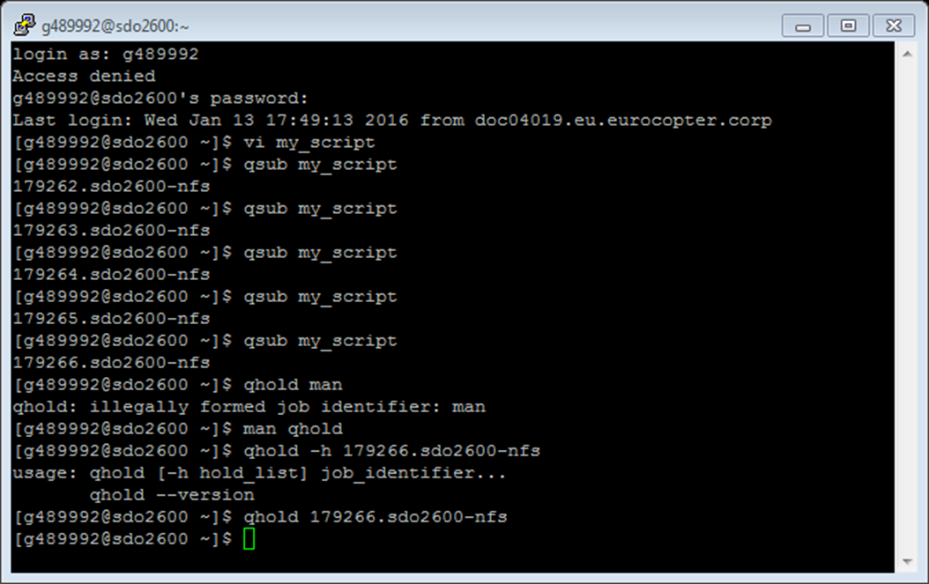

Slide 20
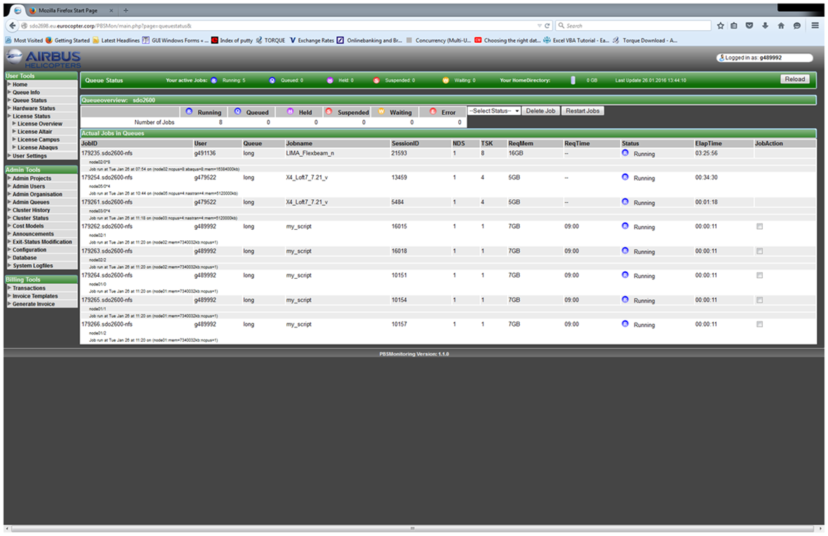
User Specific

Slide 21
User Specific in Detail
Each user can delete ,hold,restart his own jobs
'HTTP_HOST‘
Contents of the Host: header from the current request, if there is one.
'PHP_AUTH_USER'
When doing HTTP authentication this variable is set to the username provided by the user.
$logged_user=$_SERVER['PHP_AUTH_USER'];
if($username[$job]==$logged_user)
{
$jobaction='<input type="checkbox" name="chkid[]" value="'.$jobid[$job].'"/>';
}
else
{
$jobaction='';
}

Slide 22
User Specific in Detail
'PHP_AUTH_PW'
When doing HTTP authentication this variable is set to the password provided by the user.
$checkbox_id="";
if(isset($_POST['sub']))
{
echo $_POST['sub'];
$value=$_POST['chkid'];
echo $value;
foreach($value as $checkbox_id)
{
echo $checkbox_id;
$logged_user=$_SERVER['PHP_AUTH_USER'];
$logged_pwd=$_SERVER['PHP_AUTH_PW'];

Slide 23


Slide 24
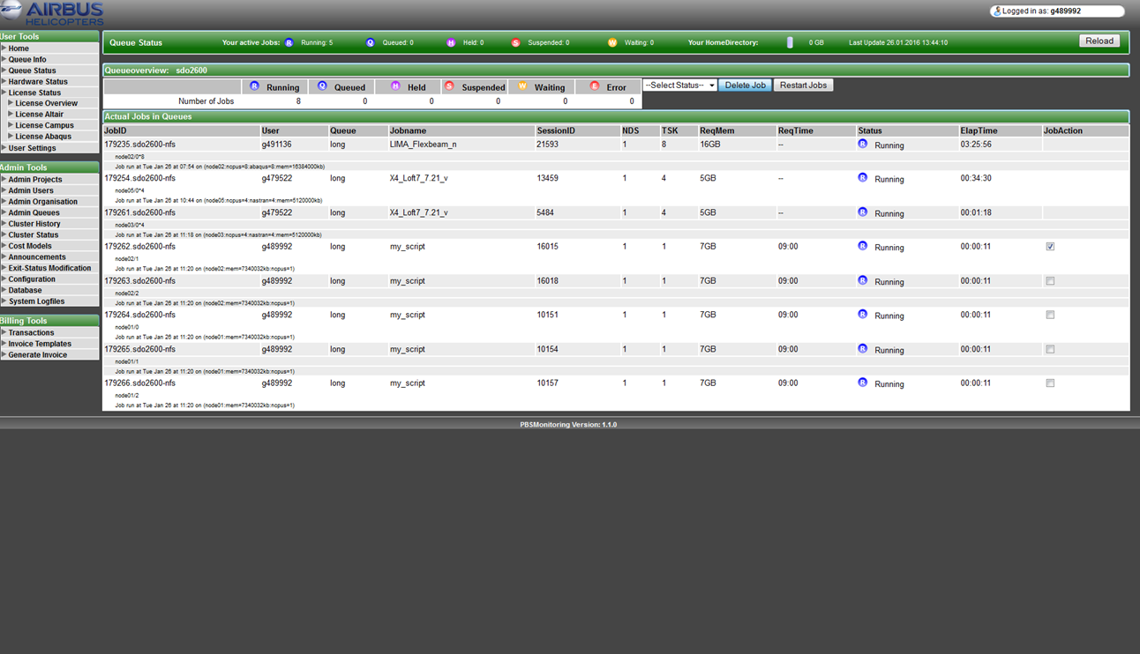

Slide 25
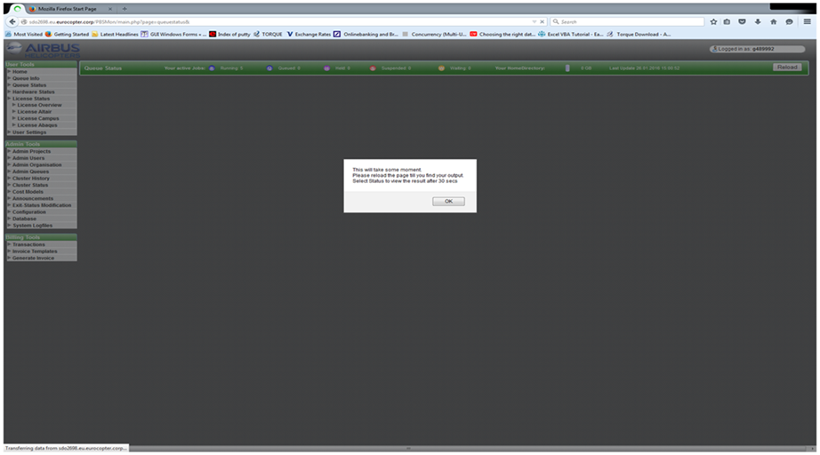
Java Script software validation

Slide 26
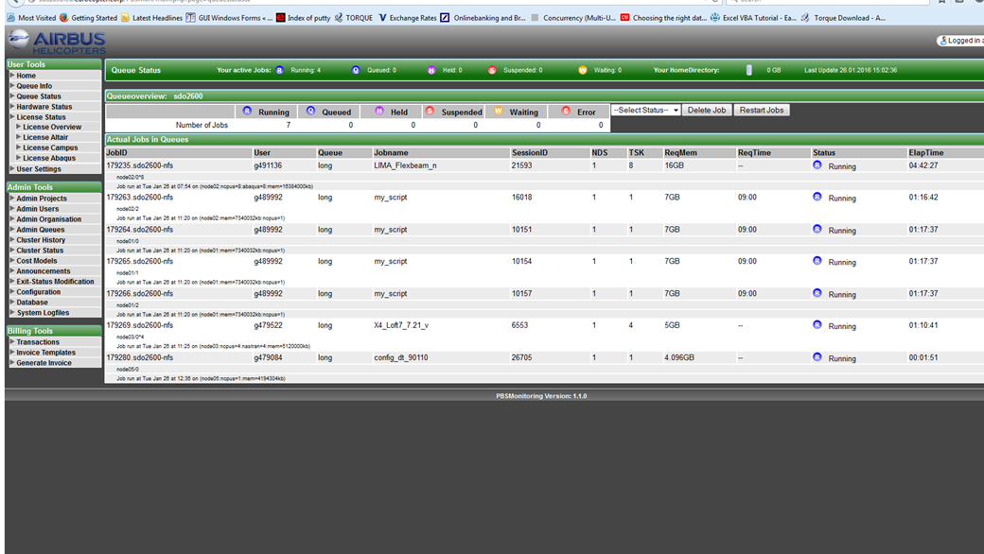
Outcomes

Slide 27
User Specific in qdel
#!/bin/bash
#set -x
echo "command started with \"$*\"" >/tmp/qdel.log
USER_NAME=$1
JOBID=$2
if [ ! "$USER_NAME" ] || [ ! "$JOBID" ]; then
echo "$0 <UserID> <JOBID>"
exit 10
fi
echo "Executing \"ssh $USER_NAME@sdo2600 \"qdel $JOBID\"\"" >>/tmp/qdel.log
ssh 1>&2 2>>/tmp/qdel.log -vvv $USER_NAME@sdo2600 "qdel $JOBID"

Slide 28
PHP exec() in qdel
exec()
exec — Execute an external program
<?php
// outputs the username that owns the running php/httpd process
// (on a system with the "whoami" executable in the path)
echo exec('whoami');
?>
shell_exec
shell_exec — Execute command via shell and return the complete output as a string

Slide 29
Eliminating PuTTy.exe by qdel
foreach($value as $checkbox_id)
{
echo $checkbox_id;
$logged_user=$_SERVER['PHP_AUTH_USER'];
logged_pwd=$_SERVER['PHP_AUTH_PW'];
exec("/usr/bin/qdel $logged_user $checkbox_id");
}
***********************************************************************************************************************************
Shell Script qdel
#!/bin/bash
#set -x
echo "command started with \"$*\"" >/tmp/qdel.log
USER_NAME=$1
JOBID=$2
if [ ! "$USER_NAME" ] || [ ! "$JOBID" ]; then
echo "$0 <UserID> <JOBID>"
exit 10
fi
echo "Executing \"ssh $USER_NAME@sdo2600 \"qdel $JOBID\"\"" >>/tmp/qdel.log
ssh 1>&2 2>>/tmp/qdel.log -vvv $USER_NAME@sdo2600 "qdel $JOBID"

Slide 30
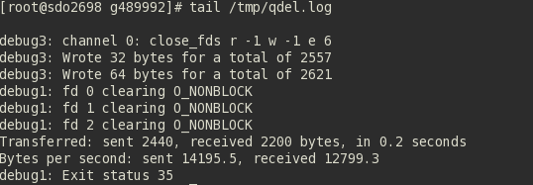
Eliminating PuTTy.exe by qdel
Log file output

Slide 31
Delete Handling
Permission denied
Httpd connect se linux -> on
[root@sdo2699 bin]# cat /tmp/qdel.log
command started with "g489992 180305.sdo2600-nfs"
Executing "ssh g489992@sdo2600 "qdel 180305.sdo2600-nfs""
OpenSSH_5.3p1, OpenSSL 1.0.1e-fips 11 Feb 2013
debug1: Reading configuration data /etc/ssh/ssh_config
debug1: Applying options for *
debug2: ssh_connect: needpriv 0
debug1: Connecting to sdo2600 [53.144.34.45] port 22.
debug1: connect to address 53.144.34.45 port 22: Permission denied
ssh: connect to host sdo2600 port 22: Permission denied
Test successful

Slide 32
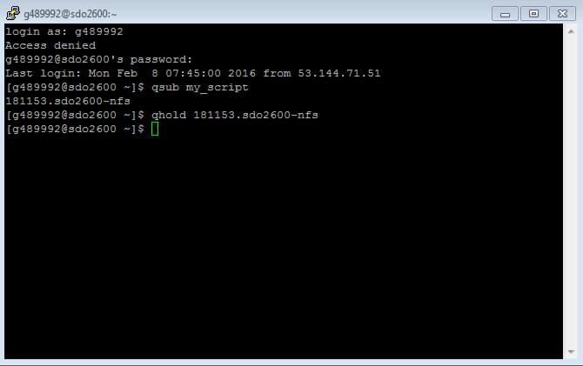
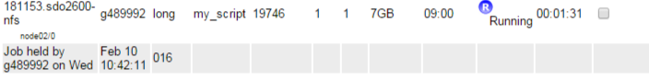
User Specific in qhold
If the user executes the qhold command on a job then the job goes into the held state but on the PBS Monitoring ;
the job status is still in running .
To restart the job use the restart button which provides the qrls functionality. After executing Restart button , the outcome shows two hypen (-).It is an indicator that the job is restarting.

Slide 33
qhold Handling
Permission denied
Httpd connect se linux setsebool -P httpd_can_network_connect ->on
[root@sdo2699 bin]# cat /tmp/qhold.log
command started with "g489992 180305.sdo2600-nfs"
Executing "ssh g489992@sdo2600 "qhold 180305.sdo2600-nfs""
OpenSSH_5.3p1, OpenSSL 1.0.1e-fips 11 Feb 2013
debug1: Reading configuration data /etc/ssh/ssh_config
debug1: Applying options for *
debug2: ssh_connect: needpriv 0
debug1: Connecting to sdo2600 [53.144.34.45] port 22.
debug1: connect to address 53.144.34.45 port 22: Permission denied
ssh: connect to host sdo2600 port 22: Permission denied
Test case failure as it command did not accept accept extra arguments
qhold [-h hold_list] job_identifier

Slide 34
User Specific in qrls
#!/bin/bash
#set -x
echo "command started with \"$*\"" >/tmp/qrls.log
USER_NAME=$1
JOBID=$2
if [ ! "$USER_NAME" ] || [ ! "$JOBID" ]; then
echo "$0 <UserID> <JOBID>"
exit 10
fi
echo "Executing \"ssh $USER_NAME@sdo2600 \"qrls $JOBID\"\"" >>/tmp/qrls.log
ssh 1>&2 2>>/tmp/qrls.log -vvv $USER_NAME@sdo2600 "qrls $JOBID"

Slide 35

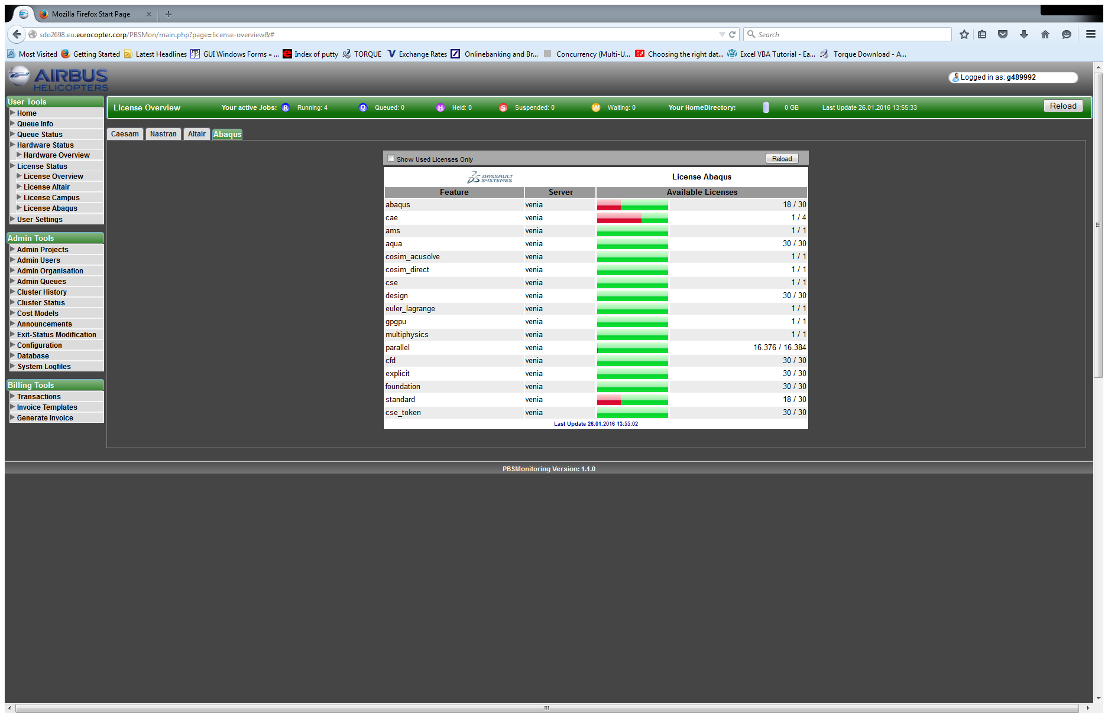
Fetching Abaqus licenses monitoring from another server

Slide 36

Migration of Web application

Slide 37
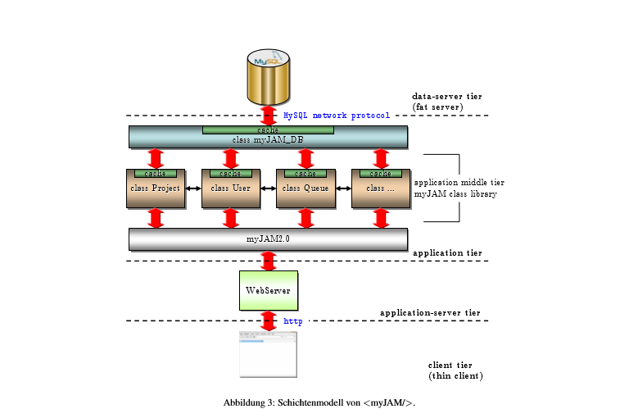
Updation
Webserver

Slide 38
Errors after migration
debug1: Connection established.
debug1: identity file /var/www/.ssh/identity type -1
debug1: identity file /var/www/.ssh/identity-cert type -1
debug1: identity file /var/www/.ssh/id_rsa type -1
debug1: identity file /var/www/.ssh/id_rsa-cert type -1
debug1: identity file /var/www/.ssh/id_dsa type -1
debug1: identity file /var/www/.ssh/id_dsa-cert type -1
debug1: identity file /var/www/.ssh/id_ecdsa type -1
debug1: identity file /var/www/.ssh/id_ecdsa-cert type -1
debug1: Remote protocol version 2.0, remote software version OpenSSH_4.3

Slide 39
Unit Testing &Regression Testing
Each Module was given more than 5 various trials.
Compatibility on all browsers
Unit testing on each extension was performed.
Regression testing was more on migration and major operations delete,hold,restart
License issues
Network issues

Slide 40
Conclusion
HPC
Architecture
System Software
Specification Fullfillment
Php exec()
Error Handling
Testing

Slide 41

References
https://www.dfn.de/fileadmin/3Beratung/DFN-Forum2/115.pdf
PBS User Guide
PBS Administration Guide
Linux Cheat sheets
php.net/manual/en/function.exec.php

